Slide 1
Fater Grand Challenge 2025
Predicting User Behavior Using Machine Learning
Churn Prediction Model & Targeted Marketing Campaigns
Rome, May 2026
Ayan Alybay

Slide 2
Agenda
1
Business Context — Coccole Pampers App
2
Data Overview & Methodology
3
Churn Analysis Results
4
Model Performance
5
User Segmentation & Insights

Slide 3
Business Context
Overview
Coccole Pampers is a loyalty mobile app designed specifically for Italian parents.
TOTAL USERS ANALYZED
6,205
Comprehensive Dataset
Core Features & Engagement
App Ecosystem: Content, Games, Community, and Loyalty Program.
Point Mechanism: Users earn points by scanning product codes and completing missions.
CHURN RATE CHALLENGE
53%
Users stopped engaging

Slide 4
Data Overview & Methodology
Dataset & Sources
6,205 unique users (Coccole Pampers)
Profiles, logins, product codes
Missions and reward history
Key Features (Variables)
Total logins & total codes scanned
Total points accumulated
User tenure & baby age
Churn Definition
> 90 Days
Consecutive inactivity period
Train/Test Split
80% Training
20% Testing
Model Architecture
XGBoost
Gradient Boosted Decision Trees

Slide 5
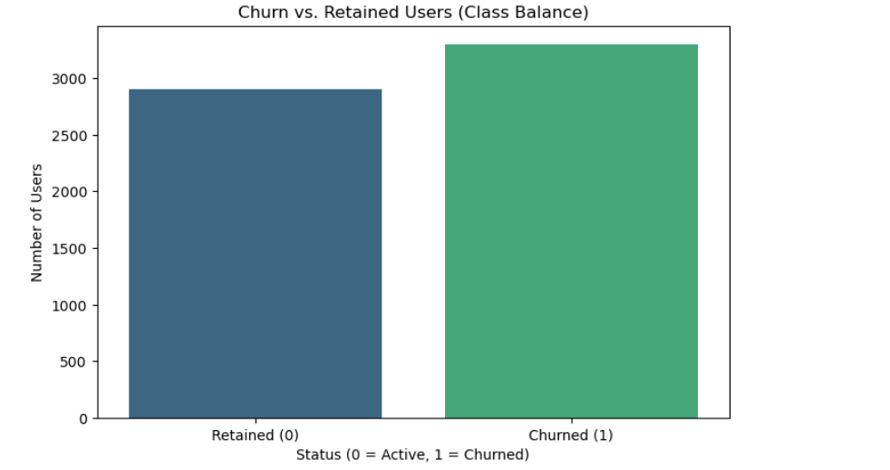
Churn Analysis Results

Slide 6
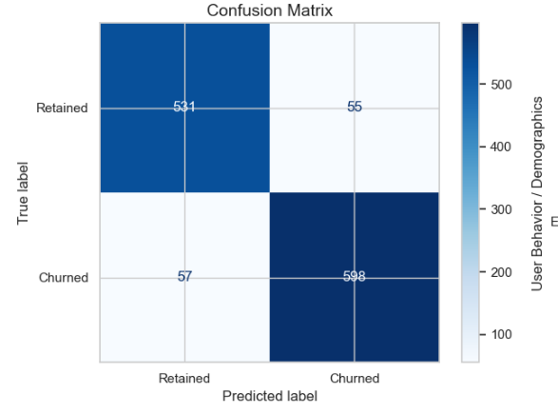
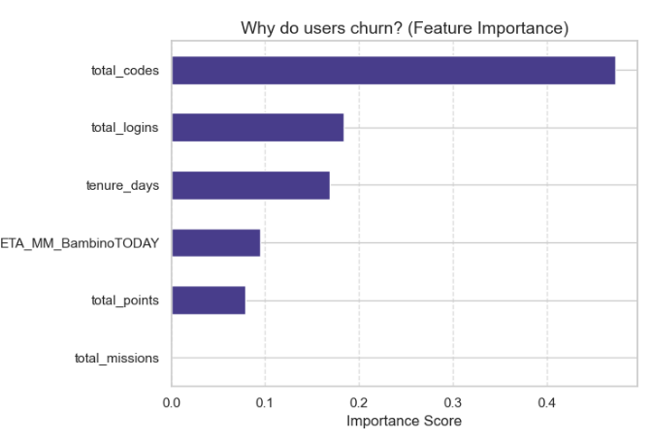
Model Performance

Slide 7
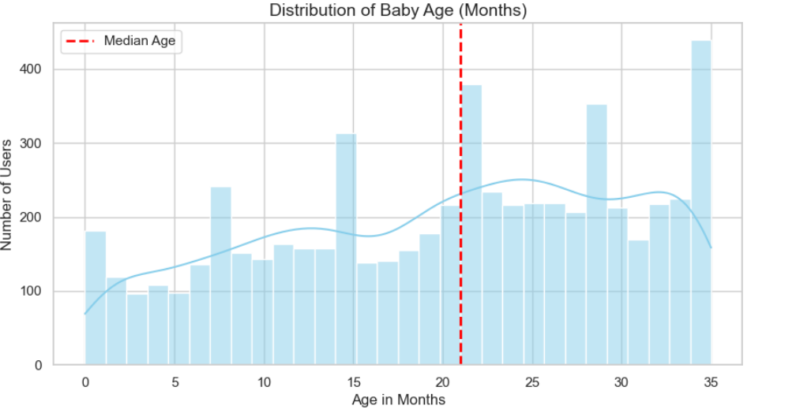
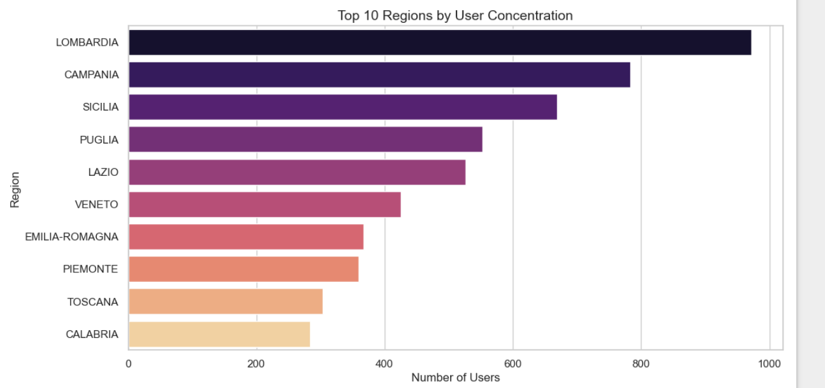
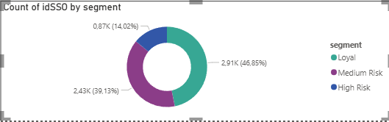
User Segmentation & Insights

Slide 8
Targeted Marketing Campaigns
HIGH RISK
14%
870 users
MEDIUM RISK
39%
2,428 users
LOYAL
47%
2,907 users
Audience Profile:
Users who never logged in after registration
Campaign Strategy:
Push notification with bonus points
Incentive just for opening the app
Audience Profile:
Users who were active but stopped engaging
Campaign Strategy:
Email "We miss you" series
Unclaimed rewards reminder
Double points missions
Audience Profile:
Highly active power users
Campaign Strategy:
Exclusive tiered rewards
Tier-based referral program
Ambassador status perks

Slide 9
Interactive Power BI Dashboard
TOTAL USERS
6,205
CHURNED USERS
~3,000
AVG CHURN RISK
53%
Dashboard Overview
Built interactive dashboard to visualize churn predictions
Dynamic filters by Region and User Segment
Real-time KPI tracking for retention teams
Key Visualizations
Segment distribution breakdown
Regional churn analysis
User age group engagement trends

Slide 10
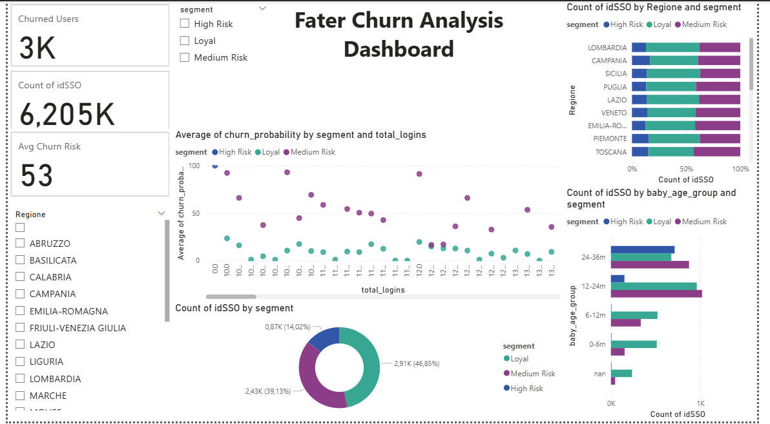

Slide 11

Conclusions & Next Steps
Key Findings
XGBoost model achieved 91% accuracy and 0.97 ROC-AUC
3 clear user segments identified: Loyal (47%), Medium Risk (39%), High Risk (14%)
Total codes scanned and app logins are the strongest churn predictors
Lombardia, Campania and Sicilia are the largest user markets
Next Steps
Deploy model in production to score users in real-time
Launch targeted campaigns for each segment
Monitor churn rate monthly and retrain model quarterly

